Slide 1

Scientific Communication
Sara Durini - sara.durini@kaust.edu.sa
Faculty Affairs Specialist
Office of the Provost
King Abdullah University of Science and Technology (KAUST)

Slide 2
Scientific communication
Day 1 - Scientific communication
Objective: introduction to scientific communication and its forms
Day 2 - Focus on scientific writing
Objective: how to write scientific texts and reports
Day 3 - Organizing your scientific paper
Objective: how to structure and write scientific papers
Day 4 - Creating your scientific poster
Objective: how to structure and write scientific posters
Day 5 - Communicating your science
Objective: how to present scientific concepts and engage your audience

Slide 3
Creating your scientific poster
Objective: how to structure and write scientific posters

Slide 4

What is a poster session
Academic conferences and scientific events provide for networking sessions.
Networking sessions are commonly referred to as poster sessions.
Poster sessions are held in halls and lobbies with rows of boards for researchers to pin their graphical summaries of their work.
These sessions provide opportunities to promote research to colleagues and prestigious attendees.
Food is often involved during poster sessions.
Attendees may walk around with drinks and a stack of pamphlets and papers.
Posters are viewable during the whole event.
Capture interest
Image created from Microsoft Bing © 2023 Microsoft

Slide 5
During the poster session
Stay close to your poster.
Network with others.
Engage with people who come close to your poster.
Present your work concisely.
Use your poster.

Slide 6
Text in a Poster
Title and Author Information:
Start with a clear and concise title that reflects the focus of your research.
Include the names of the authors and their affiliations.
Introduction:
Provide a brief introduction to your research problem or objective.
Clearly state the research question and the significance of your study.

Slide 7
Text in a Poster
Methods:
Describe the research design and methodologies used in your study.
Include the details of the algorithms, tools, or frameworks employed.
Provide enough information for the audience to understand the approach.
Results and Discussion:
Present your research findings in a clear and organized manner.
Use visual elements like graphs, charts, and tables to support your data.
Include concise captions that explain the significance of each visual.
Interpret the results and discuss their implications.

Slide 8
Text in a Poster
Conclusion:
Summarize the main outcomes of your research.
Emphasize the significance and contributions of your study.
Clearly state the implications and potential future work.
References:
List the cited sources following a specific citation style

Slide 9
Structure of a Poster
A0 size
841 x 1189 mm
Landscape orientation
A0 size
841 x 1189 mm
Portrait orientation

Slide 10
Structure of a Poster
Title and Author Information
Title and Author Information
Introduction
Results and Discussion
Introduction
Methods
Results and Discussion
Graphs
Methods
Image
Table
Conclusion
References
Conclusion
References

Slide 11
Structure of a Poster
Title and Author Information
Title and Author Information
Introduction
Methods
Introduction
Scheme
Methods
Scheme
Results and Discussion
Results and Discussion
Conclusion
References
Conclusions
References

Slide 12
Structure of a Poster
Title and Author Information
Clear text
Methods
Introduction
Left to right and top to bottom.
Clear heading, subheading and text.
Avoid large blocks of text.
Columns, alignment and spacing.
Follow poster session guidelines.
Don’t play with fonts and text colors.
Scheme
Results and Discussion
Conclusion
References

Slide 13

Structure of a Poster
Title and Author Information
Clear text
Methods
Introduction
Logical structure
Scheme
Results and Discussion
Attractive visuals
Conclusion
© 2010-2024 Freepik Company S.L.
References

Slide 14
Common mistakes
Grammar and typos.
Oversized abstract with one figure and one graph.
Formatting issues.
Too many details, words and numbers.

Slide 15
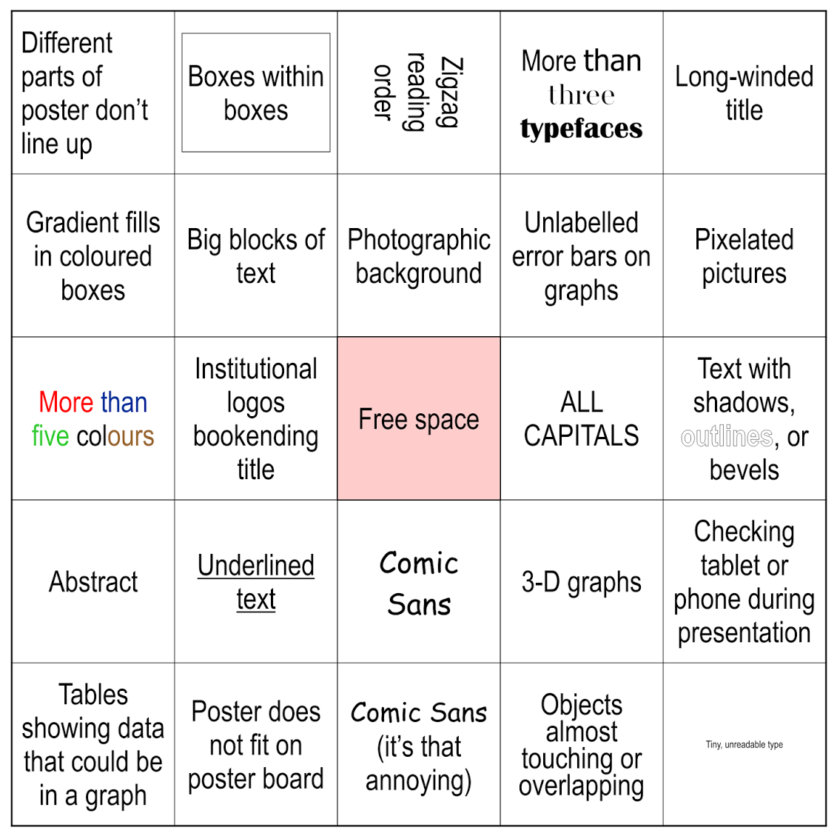
Bad poster bingo
Zen Faulkes, betterposters.blogsopt.com

Slide 16
Looking for inspiration?
https://www.animateyour.science/post/best-examples-of-scientific-posters

Slide 17
Recap: how to write scientific posters
What is a poster session
During the poster session
Use your poster
Structure of a poster
Common mistakes
HOMEWORK

